Slide 1
Wireless Networks
Reference:
Peterson and Davie, “Computer Networks: A Systems Approach”, 4th, 5th Edition, Morgan Kaufmann
(until slide 26)
EE4204/TEE4204(Part 1) Notes 6
G. Mohan / NUS

Slide 2
Wireless Links
Wireless links transmit electromagnetic signals
  Radio, microwave, infrared
Wireless links all share the same “wire” (medium)
  The challenge is to share it efficiently without unduly interfering with each other
  Most of this sharing is accomplished by dividing the “wire” along the dimensions of frequency and space
Exclusive use of a particular frequency in a particular geographic area may be allocated to an individual entity such as a corporation
  These allocations are determined by government agencies such as FCC (Federal Communications Commission) in USA
EE4204/TEE4204(Part 1) Notes 6
G. Mohan / NUS
Notes:
The University of Adelaide, School of Computer Science
Chapter 2 — Instructions: Language of the Computer

Slide 3
Band Allocation and Uses
Specific bands (frequency) ranges are allocated to certain uses
Some bands are reserved for government use
Other bands are reserved for uses such as AM radio, FM radio, televisions, satellite communications, and cell phones
Specific frequencies within these bands are then allocated to individual organizations for use within certain geographical areas.
Finally, there are several frequency bands set aside for “license exempt” usage (Bands in which a license is not needed)
Devices that use license-exempt frequencies are still subject to certain restrictions
  The first is a limit on transmission power
    This limits the range of signal, making it less likely to interfere with another signal
    For example, a cordless phone might have a range of about 100 feet.
  The second is the use of spread spectrum technique
EE4204/TEE4204(Part 1) Notes 6
G. Mohan / NUS
Notes:
The University of Adelaide, School of Computer Science
Chapter 2 — Instructions: Language of the Computer

Slide 4
Spread Spectrum Techniques
The idea is to spread the signal over a wider frequency band
    So as to minimize the impact of interference from other devices
    Originally designed for military use
    Frequency hopping
    Direct sequence
Frequency hopping
  Transmitting signal over a random sequence of frequencies
      First transmitting at one frequency, then a second, then a third…
      The sequence of frequencies is not truly random, instead computed algorithmically by a pseudorandom number generator
      The receiver uses the same algorithm as the sender, initializes it with the same seed, and is able to hop frequencies in sync with the transmitter to correctly receive the frame
EE4204/TEE4204(Part 1) Notes 6
G. Mohan / NUS
Notes:
The University of Adelaide, School of Computer Science
Chapter 2 — Instructions: Language of the Computer

Slide 5
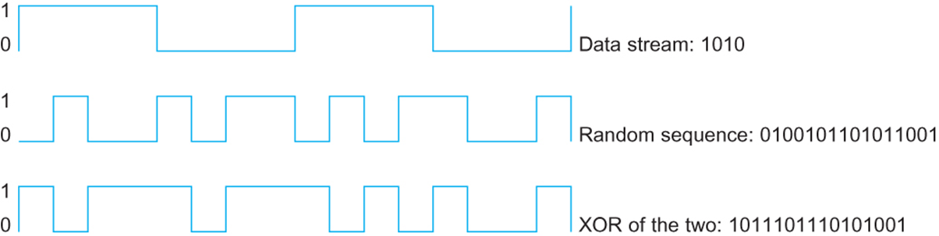
Direct Sequence Technique
  Represents each bit in the frame by multiple bits in the transmitted signal.
  For each bit the sender wants to transmit
    It actually sends the exclusive OR of that bit and n random bits
  The sequence of random bits is generated by a pseudorandom number generator known to both the sender and the receiver.
  The transmitted values, known as an n-bit chipping code, spread the signal across a frequency band that is n times wider
  Example: 4 bit chipping sequence
EE4204/TEE4204(Part 1) Notes 6
G. Mohan / NUS
Notes:
The University of Adelaide, School of Computer Science
Chapter 2 — Instructions: Language of the Computer

Slide 6
Wireless Technologies
Wireless technologies differ in a variety of dimensions
  How much bandwidth they provide
  How far apart the communication nodes can be
Some prominent wireless technologies
  Bluetooth (802.15.1)
    2 Mbps, 10 m
  Wi-Fi (802.11)
    Few hundreds of Mbps, a few Gbps, 100m
  3G cellular wireless
    few Mbps, tens of kilometers
  4G cellular wireless
    Hundreds of Mbps, tens of kilometers
EE4204/TEE4204(Part 1) Notes 6
G. Mohan / NUS
Notes:
The University of Adelaide, School of Computer Science
Chapter 2 — Instructions: Language of the Computer

Slide 7
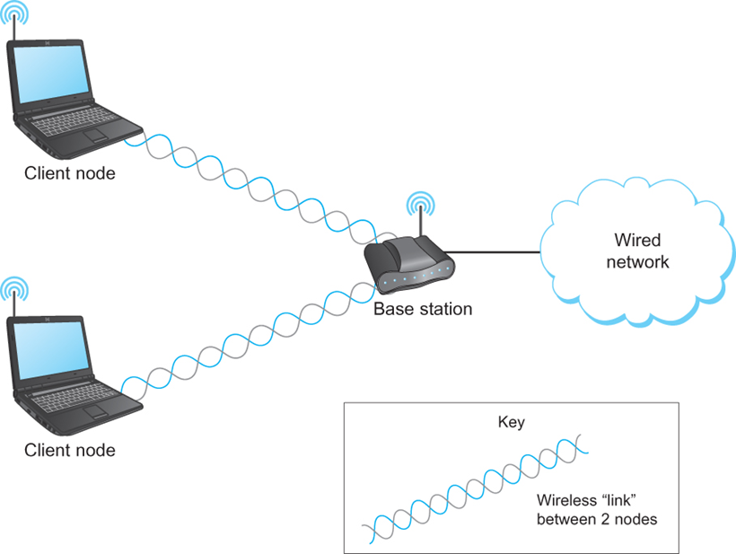
Wireless Links
Mostly widely used wireless links today are usually asymmetric
  Two end-points are usually different kinds of nodes
    One end-point usually has no mobility, but has wired connection to the Internet (known as base station)
    The node at the other end of the link is often mobile
EE4204/TEE4204(Part 1) Notes 6
G. Mohan / NUS
Notes:
The University of Adelaide, School of Computer Science
Chapter 2 — Instructions: Language of the Computer

Slide 8
Mobility of nodes
Wireless communication supports point-to-multipoint communication
Communication between non-base (client) nodes is routed via the base station
Different levels of mobility for clients
  No mobility: the receiver must be in a fix location to receive a directional transmission from the base station
    initial version of WiMAX (Worldwide Interoperability for Microwave Access)
  Mobility is within the range of a base (Bluetooth)
  Mobility between bases (Cell phones and Wi-Fi)
EE4204/TEE4204(Part 1) Notes 6
G. Mohan / NUS
Notes:
The University of Adelaide, School of Computer Science
Chapter 2 — Instructions: Language of the Computer

Slide 9
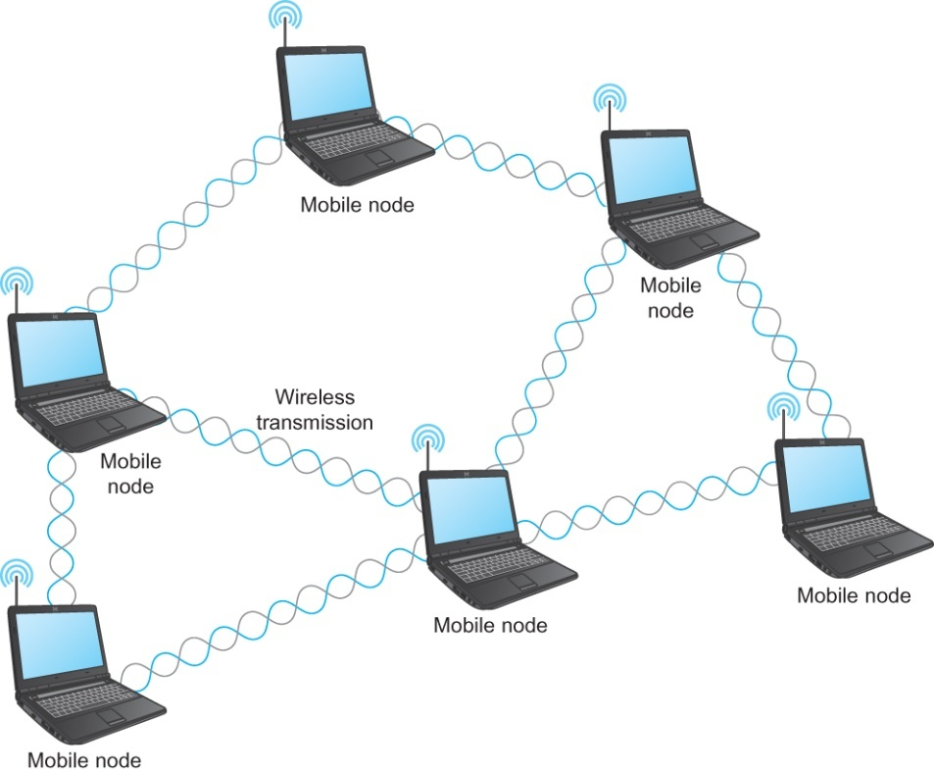
Wireless Mesh Network
Mesh or Ad-hoc network
  Nodes are peers
  Messages may be forwarded via a chain of peer nodes
A wireless ad-hoc or mesh network
EE4204/TEE4204(Part 1) Notes 6
G. Mohan / NUS
Notes:
The University of Adelaide, School of Computer Science
Chapter 2 — Instructions: Language of the Computer

Slide 10
IEEE 802.11
Also known as Wi-Fi
Like Ethernet and token LAN, 802.11 is designed for use in a limited geographical area (homes, office buildings, campuses)
  Primary challenge is to mediate access to a shared communication medium – in this case, signals propagating through space
802.11 supports additional features
  power management and
  security mechanisms
EE4204/TEE4204(Part 1) Notes 6
G. Mohan / NUS
Notes:
The University of Adelaide, School of Computer Science
Chapter 2 — Instructions: Language of the Computer

Slide 11
IEEE 802.11
Original 802.11 standard defined two radio-based physical layer standard
  One using the frequency hopping
    Over 79 1-MHz-wide frequency bandwidths
  Second using direct sequence
    Using 11-bit chipping sequence
  Both standards run in the 2.4-GHz and provide up to 2 Mbps
Then physical layer standard 802.11b was added
  Using a variant of direct sequence 802.11b provides up to 11 Mbps
  Uses license-exempt 2.4-GHz band
Then came 802.11a, up to 54 Mbps using OFDM (orthogonal FDM)
  802.11a runs on license-exempt 5-GHz band
Then came 802.11g which is backward compatible with 802.11b (Uses 2.4 GHz band, OFDM and delivers up to 54 Mbps )
802.11 n, improves on 802.11g, 2.4 GHz band, up to a few hundred Mbps, multiple antenna MIMO (multiple input multiple output) technique
802.11 ac, improves on 802.11n, 5 GHz band, up to a few Gbps, MIMO
EE4204/TEE4204(Part 1) Notes 6
G. Mohan / NUS
Notes:
The University of Adelaide, School of Computer Science
Chapter 2 — Instructions: Language of the Computer

Slide 12
802.11 Multiple Access
CSMA/CA
CS (Carrier Sense)
  Sense before starts transmission, don’t collide with ongoing transmissions
No Collision Detection
  Received signals are weak (due to fading); difficult to sense collision
  Not possible to detect all collisions
    Eg.: Hidden node problem (discussed later)
Collision Avoidance (CA)
  How to avoid collisions?
EE4204/TEE4204(Part 1) Notes 6
G. Mohan / NUS

Slide 13
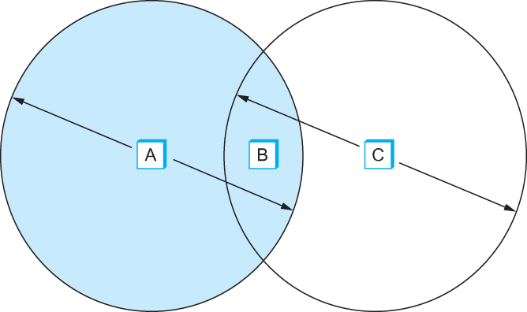
Hidden Node Problem
Consider the situation in the following figure where each node is able to send and receive signals that reach just the nodes to its immediate left and right as shown in Figure
  B can exchange frames with A and C
  C can reach B but not A
  A can reach B but not C
EE4204/TEE4204(Part 1) Notes 6
G. Mohan / NUS
Notes:
The University of Adelaide, School of Computer Science
Chapter 2 — Instructions: Language of the Computer

Slide 14
Hidden Node Problem
Suppose both A and C want to communicate with B and so they each send it a frame.
  A and C are unaware of each other since their signals do not carry that far
  These two frames collide with each other at B
    But unlike an Ethernet, neither A nor C is aware of this collision
  A and C are said to hidden nodes with respect to each other
EE4204/TEE4204(Part 1) Notes 6
G. Mohan / NUS
Notes:
The University of Adelaide, School of Computer Science
Chapter 2 — Instructions: Language of the Computer

Slide 15
Hidden Node Problem
The “Hidden Node” Problem. Although A and C are hidden from each
other, their signals can collide at B. (B’s reach is not shown.)

Slide 16
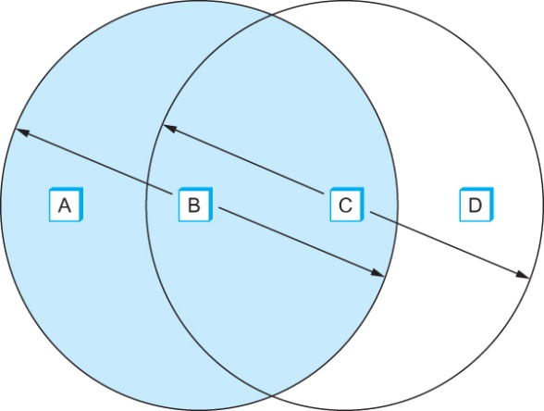
Exposed Node Problem
Consider the situation in the figure where each of four nodes is able to send and receive signals that reach just the nodes to its immediate left and right
  For example, B can exchange frames with A and C, but it cannot reach D; C can reach B and D but not A
Exposed node problem occurs
  Suppose B is sending to A. Node C is aware of this communication because it hears B’s transmission.
  It would be a mistake for C to conclude that it cannot transmit to anyone just because it can hear B’s transmission.
  Suppose C wants to transmit to node D.
  This is not a problem since C’s transmission to D will not interfere with A’s ability to receive from B.
EE4204/TEE4204(Part 1) Notes 6
G. Mohan / NUS
Notes:
The University of Adelaide, School of Computer Science
Chapter 2 — Instructions: Language of the Computer

Slide 17
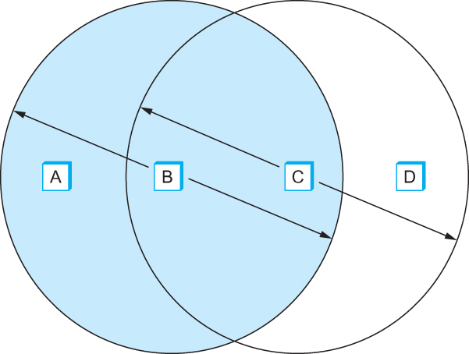
Exposed Node Problem
Exposed Node Problem. Although B and C are exposed to each other’s
signals, there is no interference if B transmits to A while C transmits to D. (A and D’s
reaches are not shown.)

Slide 18
IEEE 802.11 – Collision Avoidance
802.11 addresses these two problems (hidden node, exposed node) with an algorithm called Multiple Access with Collision Avoidance (MACA).
Key Idea
  Sender and receiver exchange control frames with each other before the sender actually transmits any data.
  This exchange informs all nearby nodes that a transmission is about to begin
  Sender transmits a Request to Send (RTS) frame to the receiver.
    The RTS frame includes a field that indicates how long the sender wants to hold the medium
      - Length of the data frame to be transmitted
  Receiver replies with a Clear to Send (CTS) frame
    This frame echoes this length field back to the sender
EE4204/TEE4204(Part 1) Notes 6
G. Mohan / NUS
Notes:
The University of Adelaide, School of Computer Science
Chapter 2 — Instructions: Language of the Computer

Slide 19
IEEE 802.11 – Collision Avoidance
Any node that sees the CTS frame knows that
  it is close to the receiver, therefore
  cannot transmit for the period of time it takes to send a frame of the specified length
  See the hidden node problem example
Any node that sees the RTS frame but not the CTS frame
  is not close enough to the receiver to interfere with it, and
  so is free to transmit (not to receive?)
  See the exposed node problem example
EE4204/TEE4204(Part 1) Notes 6
G. Mohan / NUS
Notes:
The University of Adelaide, School of Computer Science
Chapter 2 — Instructions: Language of the Computer

Slide 20
IEEE 802.11 – Collision Avoidance
Using ACK in MACA
  Proposed in MACAW: MACA for Wireless LANs
Receiver sends an ACK to the sender after successfully receiving a frame
All nodes must wait for this ACK before trying to transmit
If two or more nodes detect an idle link and try to transmit an RTS frame at the same time
  Their RTS frame will collide with each other
802.11 does not support collision detection
  So the senders realize the collision has happened when they do not receive the CTS frame after a period of time
  In this case, they each wait a random amount of time before trying again.
  The amount of time a given node delays is defined by the same exponential backoff algorithm used on the Ethernet.
EE4204/TEE4204(Part 1) Notes 6
G. Mohan / NUS
Notes:
The University of Adelaide, School of Computer Science
Chapter 2 — Instructions: Language of the Computer

Slide 21
IEEE 802.11 – Distribution System
802.11 is suitable for an ad-hoc configuration of nodes that may or may not be able to communicate with all other nodes.
  Nodes are free to move around
  The set of directly reachable nodes may change over time
  Adhoc vs. infrastructure wireless network; adhoc not studied here
To deal with this mobility and partial connectivity,
  802.11 defines additional structures on a set of nodes
  Instead of all nodes being created equal,
    some nodes are allowed to roam
    some are connected to a wired network infrastructure
      they are called Access Points (AP) and they are connected to each other by a so-called distribution system
    Infrastructure wireless LAN: communication thru APs; APs are interconnected by Ethernet switches or IP routers
EE4204/TEE4204(Part 1) Notes 6
G. Mohan / NUS
Notes:
The University of Adelaide, School of Computer Science
Chapter 2 — Instructions: Language of the Computer

Slide 22
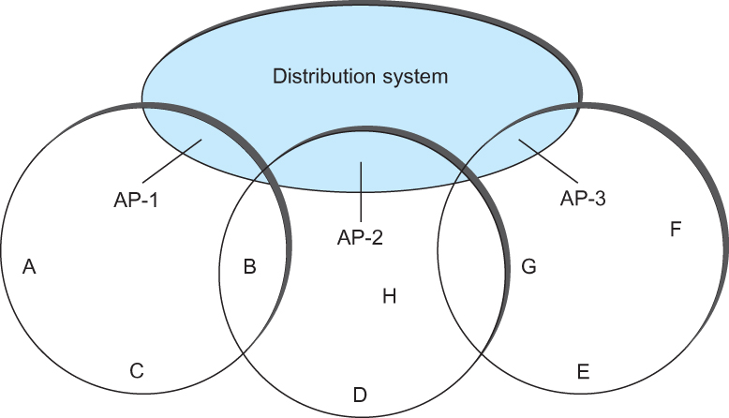
IEEE 802.11 – Distribution System
Following figure illustrates a distribution system that connects three access points, each of which services the nodes in the same region
Each of these regions is analogous to a cell in a cellular phone system with the APs playing the same role as a base station
The distribution network runs at layer 2 of the ISO architecture
Access points connected to a distribution network
EE4204/TEE4204(Part 1) Notes 6
G. Mohan / NUS
Notes:
The University of Adelaide, School of Computer Science
Chapter 2 — Instructions: Language of the Computer

Slide 23
IEEE 802.11 – Distribution System
Although two nodes can communicate directly with each other if they are within reach of each other, the idea behind this configuration is
  Each node associates itself with one access point
  For node A to communicate with node E, A first sends a frame to its AP-1 which forwards the frame across the distribution system to AP-3, which finally transmits the frame to E
Access points connected to a distribution network
EE4204/TEE4204(Part 1) Notes 6
G. Mohan / NUS
Notes:
The University of Adelaide, School of Computer Science
Chapter 2 — Instructions: Language of the Computer

Slide 24
IEEE 802.11 – Distribution System (Scanning)
How do the nodes select their access points
How does it work when nodes move from one cell to another
The technique for selecting an AP is called scanning
  The node sends a Probe frame
  All APs within reach reply with a Probe Response frame
  The node selects one of the access points and sends that AP an Association Request frame
  The AP replies with an Association Response frame
A node engages this protocol whenever
  it joins the network, as well as
  when it becomes unhappy with its current AP
    This might happen, for example, because the signal from its current AP has weakened due to the node moving away from it
    Whenever a node acquires a new AP, the new AP notifies the old AP of the change via the distribution system
EE4204/TEE4204(Part 1) Notes 6
G. Mohan / NUS
Notes:
The University of Adelaide, School of Computer Science
Chapter 2 — Instructions: Language of the Computer

Slide 25
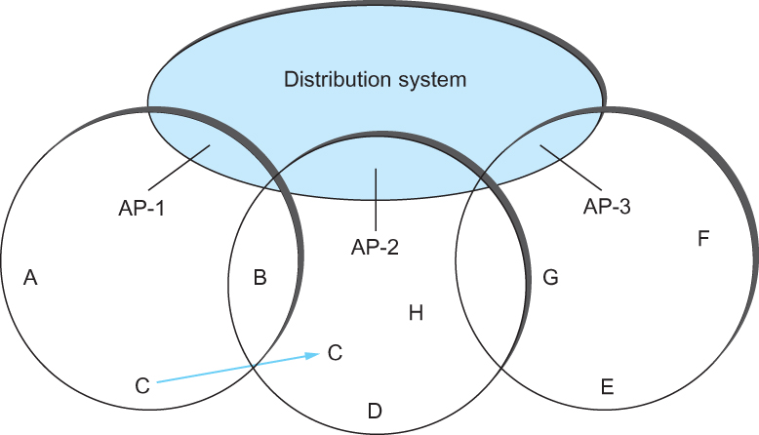
IEEE 802.11 – Distribution System (Scanning)
Consider the situation shown in the following figure when node C moves from the cell serviced by AP-1 to the cell serviced by AP-2.
As it moves, it sends Probe frames, which eventually result in Probe Responses from AP-2.
At some point, C prefers AP-2 over AP-1 , and so it associates itself with that access point.
  This is called active scanning since the node is actively searching for an access point
Node Mobility
EE4204/TEE4204(Part 1) Notes 6
G. Mohan / NUS
Notes:
The University of Adelaide, School of Computer Science
Chapter 2 — Instructions: Language of the Computer

Slide 26
IEEE 802.11 – Distribution System (Scanning)
APs also periodically send a Beacon frame that advertises the capabilities of the access point; these include the transmission rate supported by the AP
  This is called passive scanning
  A node can change to this AP based on the Beacon frame simply by sending it an Association Request frame back to the access point.
Node Mobility
EE4204/TEE4204(Part 1) Notes 6
G. Mohan / NUS
Notes:
The University of Adelaide, School of Computer Science
Chapter 2 — Instructions: Language of the Computer

Slide 27
Reference for slides 28-32
J.F. Kurose and K. W. Ross, “Computer Networking: A Top-Down Approach”, 7th Edition, Pearson
EE4204/TEE4204(Part 1) Notes 6
G. Mohan / NUS

Slide 28



802.11: passive/active scanning (Illustration)
AP 1
1
1
AP 2
1
AP 2
2
AP 1
2
2
3
3
4
H1
H1
passive scanning:
beacon frames sent from APs
association Request frame sent: H1 to selected AP
association Response frame sent from selected AP to H1
active scanning:
Probe Request frame broadcast from H1
Probe Response frames sent from APs
Association Request frame sent: H1 to selected AP
Association Response frame sent from selected AP to H1
EE4204/TEE4204(Part 1) Notes 6
G. Mohan / NUS

Slide 29
802.11 frame format
0-2312 Bytes
duration of reserved
transmission time (RTS/CTS)
16
16
48
48
48
16
48
0 - 18496
32
frame
control
duration
address
1
address
2
address
3
seq
control
address
4
payload
CRC
To correctly ack the frame, sequencing the frames
2
2
4
1
1
1
1
1
1
1
1
Protocol
version
Type
Subtype
To
AP
From
AP
More
frag
Retry
Power
mgt
More
data
WEP
Rsvd
To AP, From AP: bits define addresses for
the infrastructure mode/adhoc mode
frame type
(data, control: RTS, CTS, ACK, probe, association)
EE4204/TEE4204(Part 1) Notes 6
G. Mohan / NUS

Slide 30
802.11 frame: addresses
16
16
48
48
48
16
48
0 - 18496
32
frame
control
duration
address
1
address
2
address
3
seq
control
address
4
payload
CRC
Address 4: used only in ad hoc mode
Address 1: MAC address
of wireless host or AP
to receive this frame
Address 3: MAC address
of router interface to which AP is attached
Address 2: MAC address
of wireless host or AP
transmitting this frame
EE4204/TEE4204(Part 1) Notes 6
G. Mohan / NUS

Slide 31


802.11 frame: addressing (example)
H1 sends and IP packet thru Internet: H1 needs to send to R1 interface
Internet
H1
R1
router
R1 MAC addr H1 MAC addr
dest. address
source address
802.3 frame
AP MAC addr H1 MAC addr R1 MAC addr
address 4 typically used in adhoc network
address 1
address 2
address 3
802.11 frame
EE4204/TEE4204(Part 1) Notes 6
G. Mohan / NUS

Slide 32
802.11 frame: addressing (example)
R1 receives IP packet from Internet with destination IP address of H1
Internet
H1
R1
router
H1 MAC addr R1 MAC addr
dest. address
source address
802.3 frame
H1 MAC addr AP MAC addr R1 MAC addr
address 4 typically used in adhoc network
address 1
address 2
address 3
802.11 frame
EE4204/TEE4204(Part 1) Notes 6
G. Mohan / NUS

